Slide 1
Machine Learning
Lecture 05

Slide 2
Types of Gradient Descent
Batch Gradient Descent
Batch gradient descent updates the model’s parameters using the gradient of the entire training set.
It calculates the average gradient of the cost function for all the training examples and updates the parameters in the opposite direction.
Batch gradient descent guarantees convergence to the global minimum but can be computationally expensive and slow for large datasets.

Slide 3
Types of Gradient Descent
Stochastic Gradient Descent
Stochastic gradient descent updates the model’s parameters using the gradient of one training example at a time. It randomly selects a training dataset example, computes the gradient of the cost function for that example, and updates the parameters in the opposite direction.
Stochastic gradient descent is computationally efficient and can converge faster than batch gradient descent.
However, it can be noisy and may not converge to the global minimum.

Slide 4
Types of Gradient Descent
Mini-batch Gradient Descent
Mini-batch gradient descent updates the model’s parameters using the gradient of a small batch size of the training dataset, known as a mini-batch.
It calculates the average gradient of the cost function for the mini-batch and updates the parameters in the opposite direction.
The mini-batch gradient descent algorithm combines the advantages of batch and stochastic gradient descent.
It is the most commonly used method in practice. It is computationally efficient and less noisy than stochastic gradient descent while still being able to converge to a good solution.

Slide 5
Linear Regression with Multiple Features
Size of Plot x₁ | Locality Value x₂ | Facing Park x₃ | Distance from School x₄ | Price y
5 | 1.0 | 1 | 2 | 15
10 | 0.9 | 0 | 2.5 | 25
7 | 1.5 | 1 | 1.9 | 35
… | … | … | … | …
4 | 0.5 | 0 | 10 | 5
x⁽¹⁾
x^{(m)}
n

Slide 6
Multivariate Linear Regression
Hypothesis Function (Uni-variate)
y’ = h_{θ}(x) = θ₀ + θ₁x₁
Hypothesis Function (multivariate)
y’ = h_{θ}(x) = θ₀ + θ₁x₁ + θ₂x₂ + … + θ_{n}x_{n}
where, x_{j} is jth feature
n is the number of features
y’ = h_{θ}(x) = θ₀x₀ + θ₁x₁ + θ₂x₂ + … + θ_{n}x_{n} where x₀ = 1
θ^{T} = [θ₀, θ₁, θ₂, …, θ_{n}]^{T}, x^{T} = [x₀ , x₁ , x₂ , … , x_{n}] ^{T}
y’ = h_{θ}(x) = θ^{T}x

Slide 7
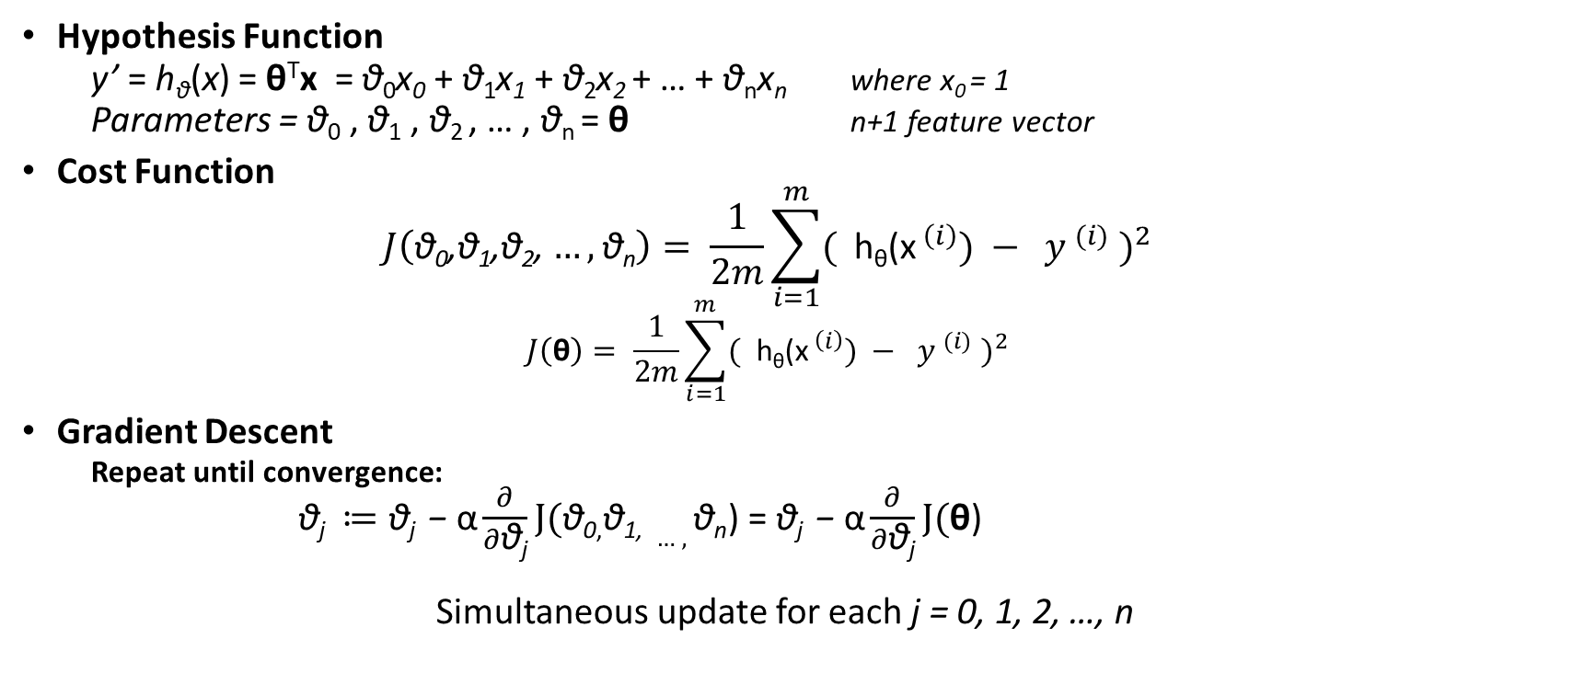
Gradient Descent For Multivariate Linear Regression
Hypothesis Function
y’ = h_{θ}(x) = θ^{T}x = θ₀x₀ + θ₁x₁ + θ₂x₂ + … + θ_{n}x_{n} where x₀ = 1
Parameters = θ₀ , θ₁ , θ₂ , … , θ_{n} = θ n+1 feature vector
Cost Function
$$J\left(\text{θ}\text{0}\text{,}\text{θ}\text{1}\text{,}\text{θ}\text{2}\text{,}…,\text{θ}\text{n}\right)= \frac{1}{2m}\sum_{i=1}^{m}{{( {\text{h}\text{θ}\text{(}\text{x}}^{ \left(i\right)}) − y^{ (i)} )}^{2}}$$
$$J\left(\text{θ}\right)= \frac{1}{2m}\sum_{i=1}^{m}{{( {\text{h}\text{θ}\text{(}\text{x}}^{ \left(i\right)}) − y^{ (i)} )}^{2}}$$
Gradient Descent
Repeat until convergence:
$\text{θ}\text{j} ≔\text{θ}\text{j}\text{ −} \text{α}\frac{∂}{∂\text{θ}\text{j}}J(\text{θ}\text{0}\text{,}\text{θ}\text{1}\text{, }…,\text{θ}\text{n}$) = $\text{θ}\text{j}\text{ −} \text{α}\frac{∂}{∂\text{θ}\text{j}}J(\text{θ}$)
Simultaneous update for each j = 0, 1, 2, …, n

Slide 8
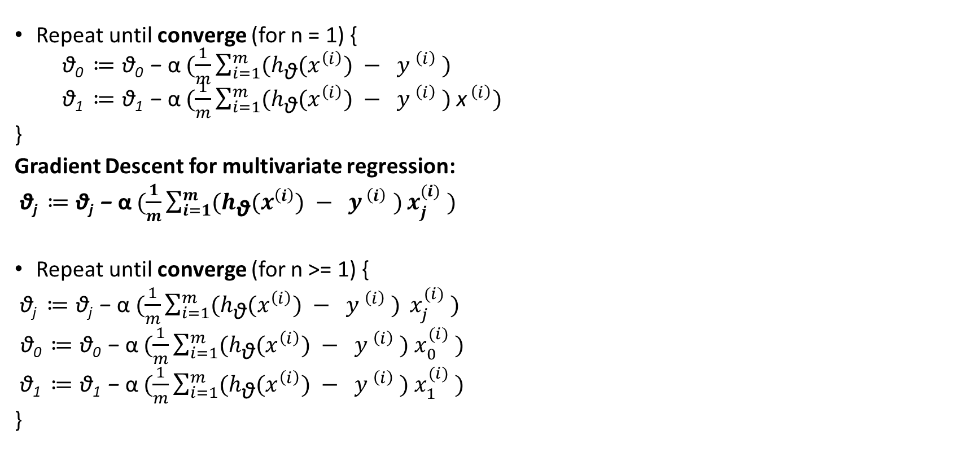
Gradient Descent for Multivariate Regression
Repeat until converge (for n = 1) {
$\text{θ}\text{0} ≔\text{θ}\text{0} \text{−} \text{α} (\frac{1}{m}\sum_{i=1}^{m}{{(h}_{\text{θ}}{(x}^{\left(i\right)}) − y^{ \left(i\right)} )}$
$\text{θ}\text{1} ≔\text{θ}\text{1} \text{−} \text{α} (\frac{1}{m}\sum_{i=1}^{m}{{(h}_{\text{θ}}{(x}^{\left(i\right)}) − y^{ \left(i\right)} )}$ ${\text{x}}^{ \left(i\right)})$
}
Gradient Descent for multivariate regression:
$\text{θ}\text{j} ≔\text{θ}\text{j}\text{ −} \text{α} (\frac{1}{m}\sum_{i=1}^{m}{{(h}_{\text{θ}}{(x}^{\left(i\right)}) − y^{ \left(i\right)} )}{x_{j}^{(i)}}^{ })$
Repeat until converge (for n >= 1) {
$\text{θ}\text{j} ≔\text{θ}\text{j} \text{−} \text{α} (\frac{1}{m}\sum_{i=1}^{m}{{(h}_{\text{θ}}{(x}^{\left(i\right)}) − y^{ \left(i\right)} ) }{x_{j}^{(i)}}^{ })$
$\text{θ}\text{0} ≔\text{θ}\text{0} \text{−} \text{α} (\frac{1}{m}\sum_{i=1}^{m}{{(h}_{\text{θ}}{(x}^{\left(i\right)}) − y^{ \left(i\right)} )}$ ${x_{0}^{(i)}}^{ })$
$\text{θ}\text{1} ≔\text{θ}\text{1} \text{−} \text{α} (\frac{1}{m}\sum_{i=1}^{m}{{(h}_{\text{θ}}{(x}^{\left(i\right)}) − y^{ \left(i\right)} )}$ ${x_{1}^{(i)}}^{ })$
}

Slide 9
Feature Scaling
If features are not on equal footings (e.g. income and age) then, algorithm may give undue weight to features with larger numerical ranges which will lead to skewed results.
Feature scaling is the process of transforming features to a common scale.
Gradient descent converge faster when the input features are on a similar scale.
Different Strategies can be used, normalization, Standardization, Maximum Absolute Scaling etc.

Slide 10
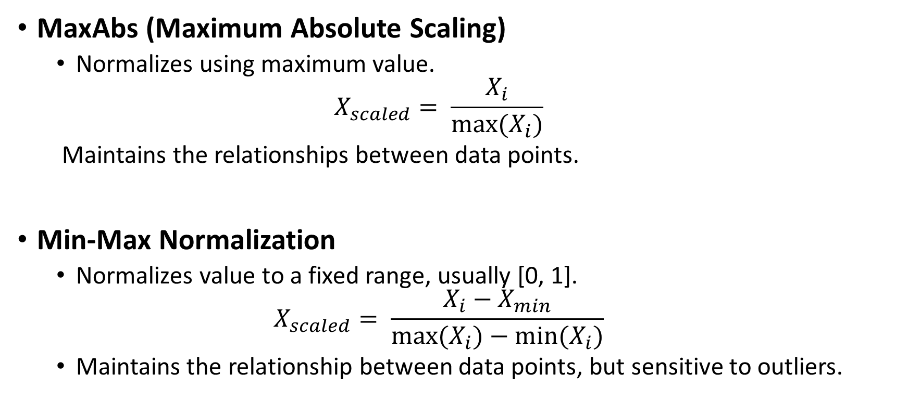
Feature Scaling
MaxAbs (Maximum Absolute Scaling)
Normalizes using maximum value.
$$X_{scaled}= \frac{X_{i}}{max⁡(X_{i})}$$
Maintains the relationships between data points.
Min-Max Normalization
Normalizes value to a fixed range, usually [0, 1].
$$X_{scaled}= \frac{X_{i}−X_{min}}{{max⁡(X}_{i})−{min⁡(X}_{i})}$$
Maintains the relationship between data points, but sensitive to outliers.

Slide 11
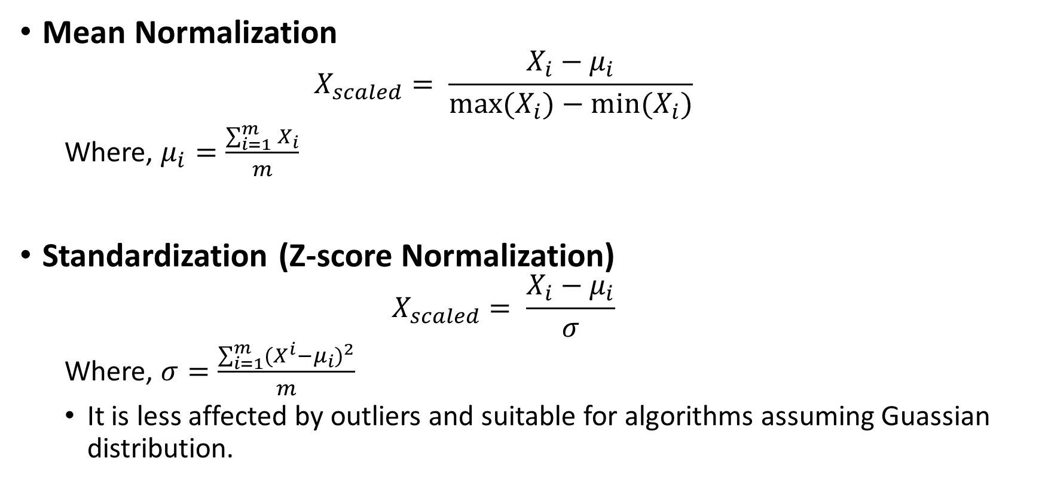
Feature Scaling
Mean Normalization
$$X_{scaled}= \frac{X_{i}−μ_{i}}{{max⁡(X}_{i})−{min⁡(X}_{i})}$$
Where, $μ_{i}=\frac{\sum_{i=1}^{m}{X_{i}}}{m}$
Standardization (Z-score Normalization)
$$X_{scaled}= \frac{X_{i}−μ_{i}}{σ}$$
Where, $σ=\frac{\sum_{i=1}^{m}{{{(X}^{i}−μ_{i})}^{2}}}{m}$
It is less affected by outliers and suitable for algorithms assuming Guassian distribution.

Slide 12
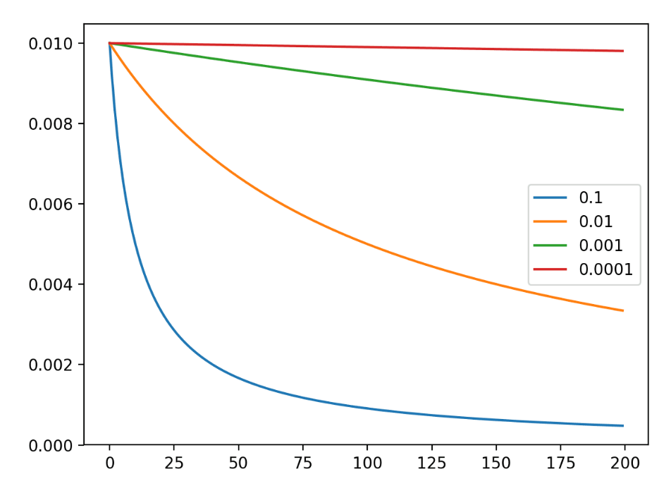
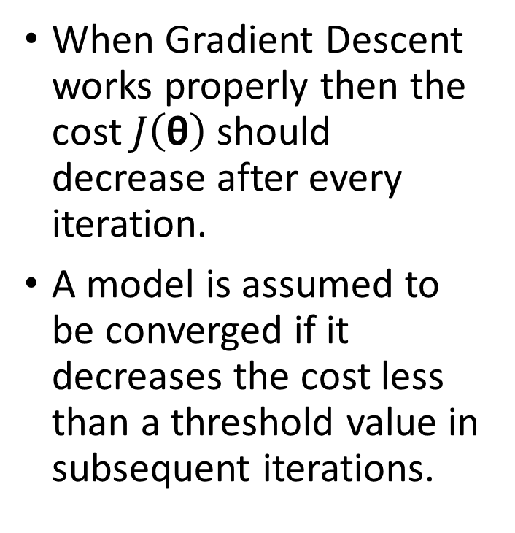
Selection of Learning Rate
When Gradient Descent works properly then the cost $J\left(\text{θ}\right)$should decrease after every iteration.
A model is assumed to be converged if it decreases the cost less than a threshold value in subsequent iterations.

Slide 13
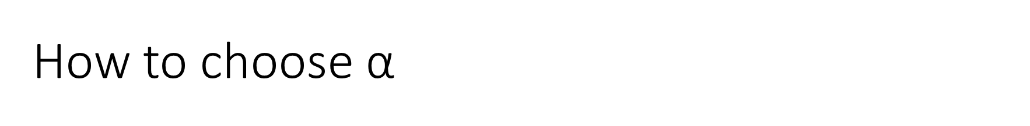
How to choose $\text{α}$
Gradient Descent doesn’t work properly if cost increases or fluctuates in subsequent iterations.
Solution: try a smaller learning rate.
If learning rate is too small: slow convergence
If learning rate is too large: Gradient descent might not converge
Solution: Try a range of values for the learning rate and then pick the best.

Slide 14

Update Rule
Choose a small initial value. Say, $\text{α}\text{ = 0.001}$
Go for roughly 3 fold increase or 10 fold increase etc.
Debugging

Slide 15
Feature Engineering
Feature engineering is the process of transforming raw data into meaningful, informative, and actionable inputs (features) for machine learning models, often using domain knowledge.
It involves selecting, manipulating, and creating new variables to enhance model accuracy, reduce complexity, and improve performance.
Purpose: The primary goal is to improve model accuracy and, in many cases, make it easier for algorithms to learn patterns, such as transforming non-linear relationships to linear ones.

Slide 16
Common Techniques of Feature Engineering
Imputation: Filling in missing values (e.g., mean, median, mode).
Encoding: Converting categorical data (e.g., "Red", "Blue") into numerical values using techniques like One-Hot Encoding.
Feature Transformation: Applying mathematical operations like logs or square roots to fix skewness.
Feature Scaling: Scaling up or down the feature to a consistent range. After a scaling operation, the continuous features become similar in terms of range.
Feature Creation: Generating new features from existing ones, such as extracting "Day of Week" from a timestamp or calculating "Area" from "Length" and "Width".
Handling Outliers: Removing or capping extreme values that can skew model training. The outliers could be handled as missing values and replaced with suitable imputation.

Slide 17
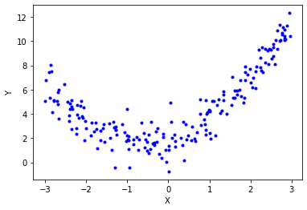
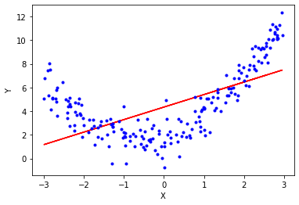
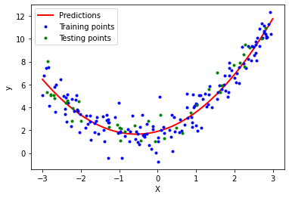
Polynomial Regression
If the relationship between data is not linear:
y’ = h_{θ}(x) = θ₀ + θ₁x₁+ θ₂x₂² + θ₃x₃³

Slide 18

Normal Equation
Method to solve for θ analytically
$${θ={(X^{T}X)}^{−1}X}^{T}Y$$

Slide 19
Comparison of Gradient Descent and Normal Equation
Gradient Descent
Need to choose learning rate
Need many iterations
Normal Equation
No Need to choose learning rate
No iterations required

Slide 20
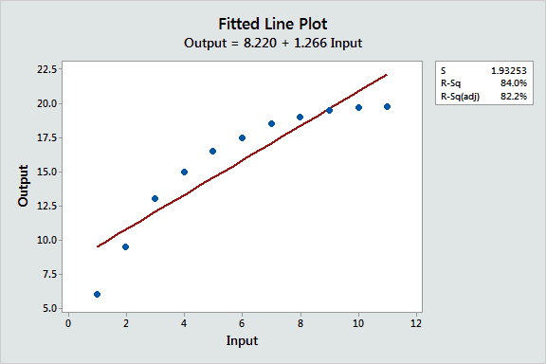
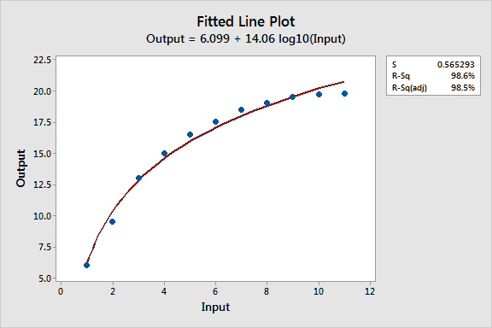
Quadratic Model
Quadratic Model

